Slide 1
Assembly Language: Stack and Procedures
CSE 315
Microprocessors, Microcontrollers, and Embedded Systems

Slide 2
Stack Segment
A block of memory to store stack
Syntax
.STACK size
Where size is optional and specifies the stack area size in bytes
If size is omitted, 1 KB set aside for stack area
For example:
.STACK 100h
SS contains segment number of stack segment
SP contains offset address of the top of the stack

Slide 3
PUSH
AX
1234
CX
SP
0100
PUSH source
source is a 16-bit register / memory word
PUSH AX
SP is decreased by 2
Source content is copied to the address SS:SP
BP
0100
00EE
00F0
00F2
00F4
00F6
00F8
00FA
00FC
00FE
SP
0100
BP

Slide 4
PUSH
AX
1234
CX
SP
00FE
PUSH source
source is a 16-bit register / memory word
PUSH AX
SP is decreased by 2
Source content is copied to the address SS:SP
BP
0100
00EE
00F0
00F2
00F4
00F6
00F8
00FA
00FC
00FE
SP
0100
BP

Slide 5
PUSH
AX
1234
CX
SP
00FE
PUSH source
source is a 16-bit register / memory word
PUSH AX
SP is decreased by 2
Source content is copied to the address SS:SP
BP
0100
00EE
00F0
00F2
00F4
00F6
00F8
00FA
00FC
SP
00FE
0100
BP

Slide 6
PUSH
AX
1234
CX
SP
00FE
PUSH source
source is a 16-bit register / memory word
PUSH AX
SP is decreased by 2
Source content is copied to the address SS:SP
BP
0100
1234
00EE
00F0
00F2
00F4
00F6
00F8
00FA
00FC
SP
00FE
0100
BP

Slide 7
POP
AX
1234
CX
SP
00FE
P0P destination
destination is a 16-bit register(except IP register) / memory word
POP CX
The content of SS:SP is moved to the destination
SP is increased by 2
BP
0100
1234
00EE
00F0
00F2
00F4
00F6
00F8
00FA
00FC
SP
00FE
0100
BP

Slide 8
POP
AX
1234
CX
1234
SP
00FE
P0P destination
destination is a 16-bit register(except IP register) / memory word
POP CX
The content of SS:SP is moved to the destination
SP is increased by 2
BP
0100
1234
00EE
00F0
00F2
00F4
00F6
00F8
00FA
00FC
SP
00FE
0100
BP

Slide 9
POP
AX
1234
CX
1234
SP
0100
P0P destination
destination is a 16-bit register(except IP register) / memory word
POP CX
The content of SS:SP is moved to the destination
SP is increased by 2
BP
0100
1234
00EE
00F0
00F2
00F4
00F6
00F8
00FA
00FC
SP
00FE
0100
BP

Slide 10
POP
AX
1234
CX
1234
SP
0100
P0P destination
destination is a 16-bit register(except IP register) / memory word
POP CX
The content of SS:SP is moved to the destination
SP is increased by 2
BP
0100
1234
00EE
00F0
00F2
00F4
00F6
00F8
00FA
00FC
00FE
SP
0100
BP

Slide 11
Order of PUSH and POP
PUSH A PUSH B
PUSH C
...
…
POP C
POP B
POP A

Slide 12
Procedure Declaration
name PROC type
; body of the procedure
RET
name ENDP
“name” is the user-defined name of the procedure
“type” is optional, can be “FAR”/”NEAR”
“RET” causes control back to the calling procedure

Slide 13
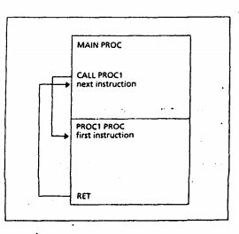
name PROC type
; body of the procedure
RET
name ENDP
Fig: Procedure CALL and RET

Slide 14
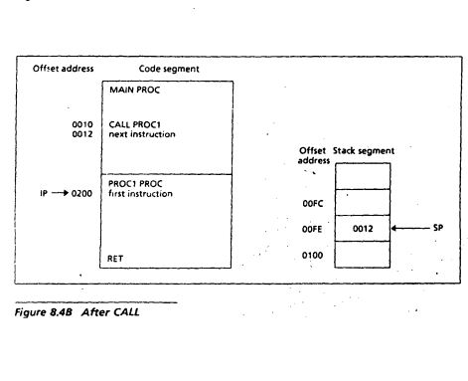
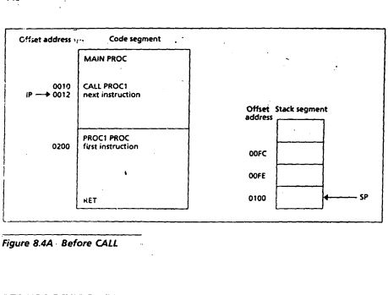
CALL

Slide 15
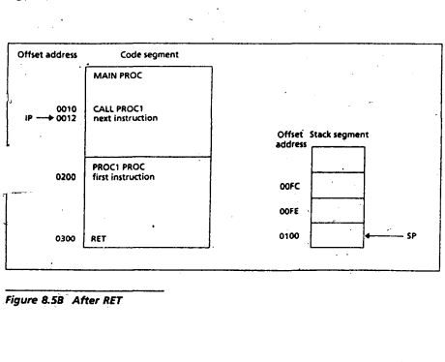
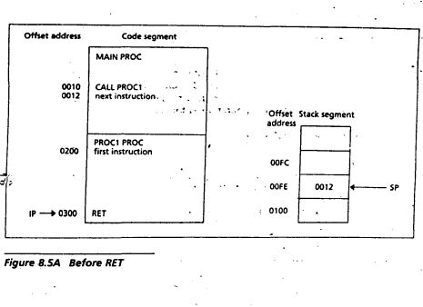
RET

Slide 16
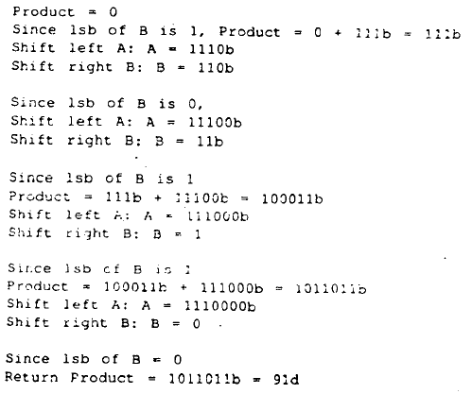

Example of a procedure
Unsigned multiplication of two positive integers A and B by addition and bit shifting
Product = 0
REPEAT
IF lsb of B is 1
THEN
Product= Product+A
END_IF
Shift left A
Shift right B
UNTIL B=0

Slide 17
Example of a procedure
Unsigned multiplication of two positive integers A and B by addition and bit shifting
Product = 0
REPEAT
IF lsb of B is 1
THEN
Product= Product+A
END_IF
Shift left A
Shift left B
UNTIL B=0
.MODEL SMALL
.STACK 100H
.CODE
MAIN PROC
MOV AX, @DATA
MOV DS, AX
MOV AX, 10
MOV BX, 6
CALL MULTIPLY
…
MOV AH, 4CH
INT 21H
MAIN ENDP
MULTIPLY PROC
PUSH AX
PUSH BX
XOR DX, DX
REPEAT:
TEST BX, 1
JZ END_IF
ADD DX,AX
END_IF:
SHL AX,1
SHR BX,1
JNZ REPEAT
POP BX
POP AX
RET
MULTIPLY ENDP
END MAIN

Slide 18
References
Ch 8 Assembly Language Programming – by Yu and Marut

